Slide 1

GURU NANAK INSTITUTE OF TECHNOLOGY
Department Of Computer Science and Engineering
FASHION RECOMMENDATION SYSTEM USING SOCIAL MEDIA WEBSITE
UNDER THE GUIDANCE OF
Ms. P.Anusha
Assistant Professor,GNIT
TEAM MEMBERS
K.NIKHIL SARADHI – 21831A0587
K.SRAVAN KUMAR - 21831A0590
M.TEJESH - 21831A05B0

Slide 2
ABSTRACT
In the ever-evolving world of fashion, personalized recommendation systems play a critical role in enhancing user experience and boosting sales for e-commerce platforms. This project aims to develop a fashion recommendation system leveraging deep learning techniques, specifically focusing on Convolutional Neural Networks (CNN) and DenseNet121. By employing these models, the system will analyze visual features of clothing items to provide accurate and tailored recommendations. The system is expected to overcome the limitations of traditional recommendation methods by learning complex visual patterns and enhancing feature extraction. This work contributes to the field by showcasing the potential of deep learning in building scalable and efficient recommendation systems for fashion.

Slide 3
INTRODUCTION
Fashion recommendation systems have become indispensable in modern online shopping, offering users personalized experiences and helping retailers increase customer engagement. Traditional systems often rely on collaborative filtering and content-based methods, which, while effective, face significant limitations in comprehending visual similarities and user preferences comprehensively. Deep learning, with its ability to capture intricate patterns and learn from large datasets, provides a new approach to developing such systems. This project proposes a deep learning-based fashion recommendation system utilizing CNNs for image analysis and DenseNet121 for enhanced feature extraction and network efficiency. The objective is to create a robust system capable of analyzing fashion items and recommending similar or complementary pieces based on visual features.

Slide 4
LITERATURE SURVEY
Title: A review of digital fashion research: Before and beyond communication and marketing.
Author: T. H. Nobile, A. Noris, N. Kalbaska, and L. Cantoni.
Year: 2021
Description:This paper focuses on the field of digital fashion and its development by providing an overview regarding fashion design and culture. It is part of a larger research that involved a literature review of 491 relevant papers. From the analysis of this corpus, three main categories were identified: Communication and Marketing, Design and Production and Culture and Society. This study focuses on the categories Design and Production and Culture and Society, which collectively gathered indicatively 48% of the selected literature. It presents its relevant studies and sub-categories, providing a rich and varied map of them and contributing to better design in further research in digital fashion.

Slide 5
EXISTING SYSTEM
DBSCAN (DENSITY-BASED SPATIAL CLUSTERING OF APPLICATIONS WITH NOISE)
DBSCAN is a density-based clustering algorithm that groups together points that are close to each other based on a distance measurement and a minimum number of points. It identifies clusters of arbitrary shape and can also detect noise (outliers) in the dataset. This characteristic makes DBSCAN particularly useful in various applications where the data is not uniformly distributed.

Slide 6
DISADVANTAGES
High Parameter Sensitivity
Struggles with High-Dimensional Data
Scalability Issues
Inconsistent Performance with Varying Densities
Noise Classification

Slide 7
PROPOSED SYSTEM
CONVOLUTIONAL NEURAL NETWORK (CNN)
Convolutional Neural Networks (CNNs) are a type of deep learning model primarily used for processing data that has a grid-like topology, such as images. They are designed to automatically and adaptively learn spatial hierarchies of features from input images, making them highly effective for tasks like image classification, object detection, and image segmentation.

Slide 8
DENSE CONVOLUTIONAL NETWORK (DENSENET)
DenseNet (Dense Convolutional Network) is a type of convolutional neural network architecture introduced to improve the flow of information and gradients throughout the network. It was proposed by Gao Huang and others in their 2017 paper titled "Densely Connected Convolutional Networks". DenseNet connects each layer to every other layer in a feed-forward fashion, which means that each layer receives inputs from all the preceding layers and passes its feature maps to all subsequent layers.

Slide 9
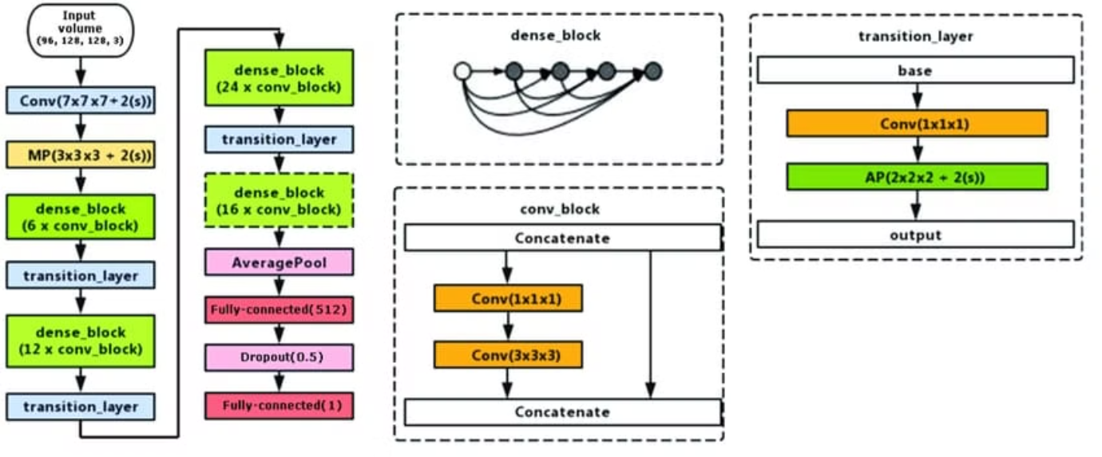

Slide 10
ADVANTAGES
Feature Extraction Capabilities
Handling High-Dimensional Data
Improved Accuracy and Precision
Adaptability and Generalization
Real-Time Recommendation Capability

Slide 11

CNN SYSTEM ARCHITECTURE

Slide 12
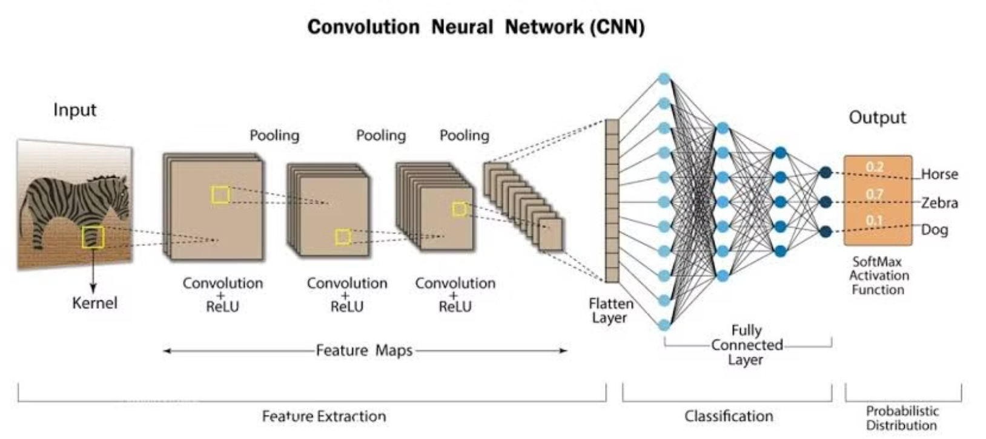
CNN EXAMPLE

Slide 13
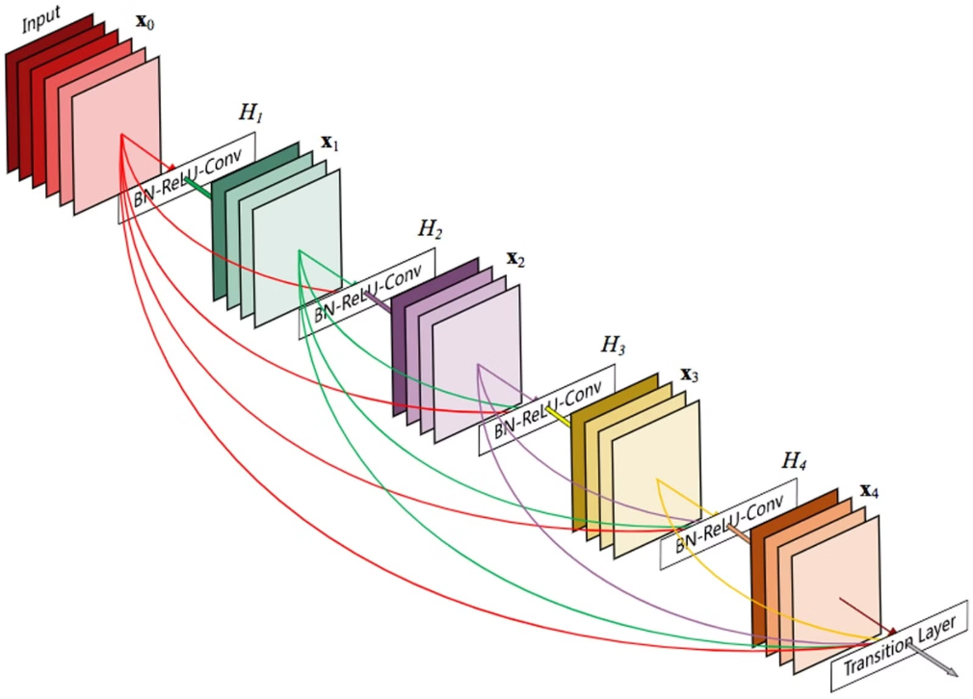
DENSENET SYSTEM ARCHITECTURE

Slide 14
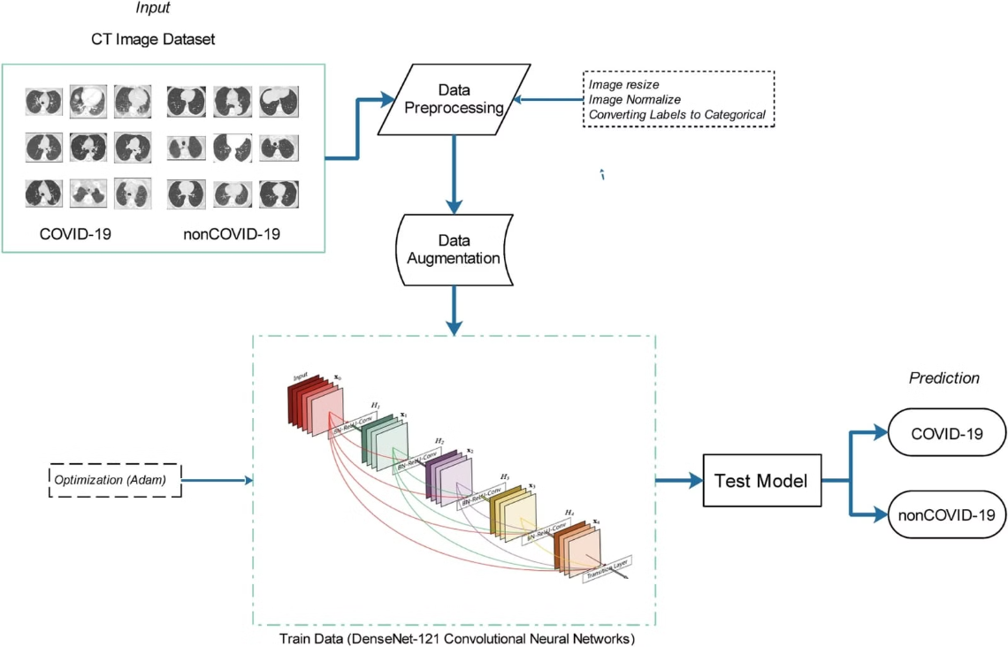
DENSENET EXAMPLE

Slide 15
MODULES
Dataset
Importing the necessary libraries
Retrieving the images
Splitting the dataset
Building the model
Apply the model and plot the graphs for accuracy and loss
Accuracy on test set
Saving the Trained Model

Slide 16
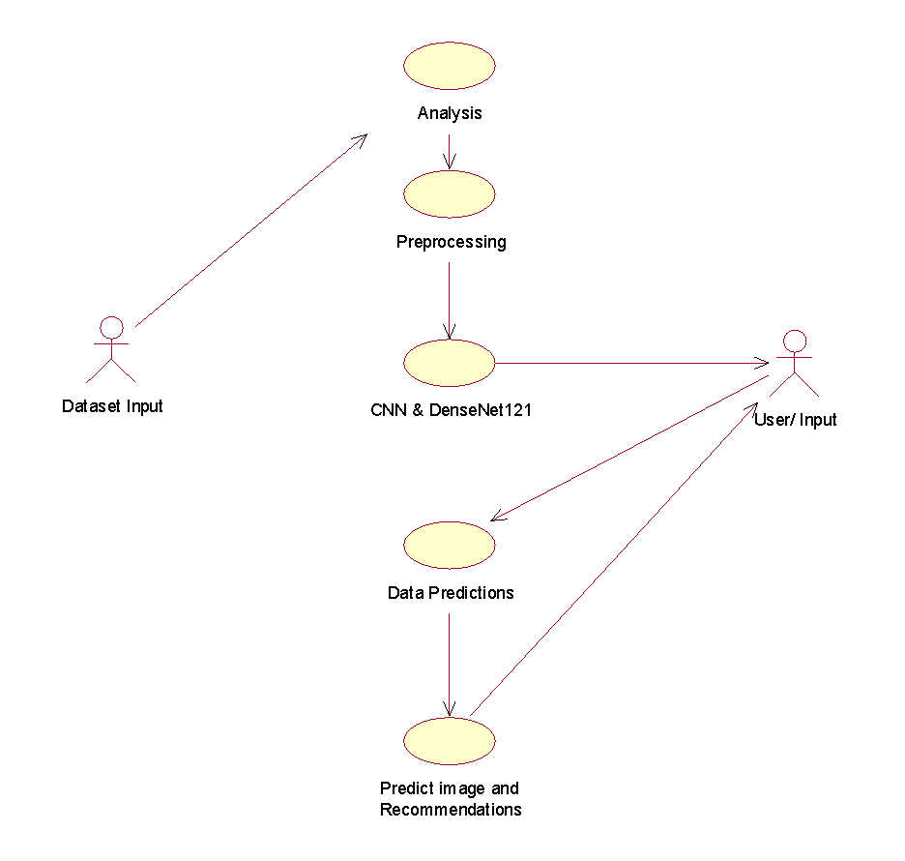
UML DIAGRAMS
USE CASE DIAGRAM
The main purpose of a use case diagram is to show what system functions are performed for which actor. Roles of the actors in the system can be depicted. The above diagram consists of user as actor. Each will play a certain role to achieve the concept.

Slide 17
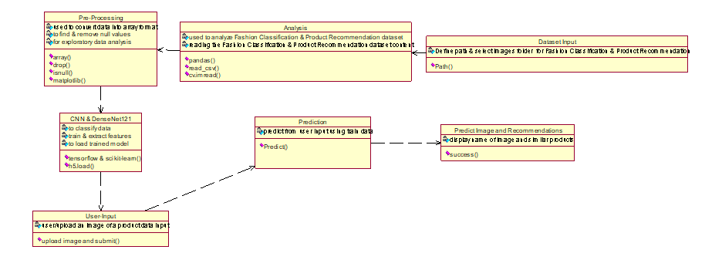
CLASS DIAGRAM
In this class diagram represents how the classes with attributes and methods are linked together to perform the verification with security. From the above diagram shown the various classes involved in our project.

Slide 18
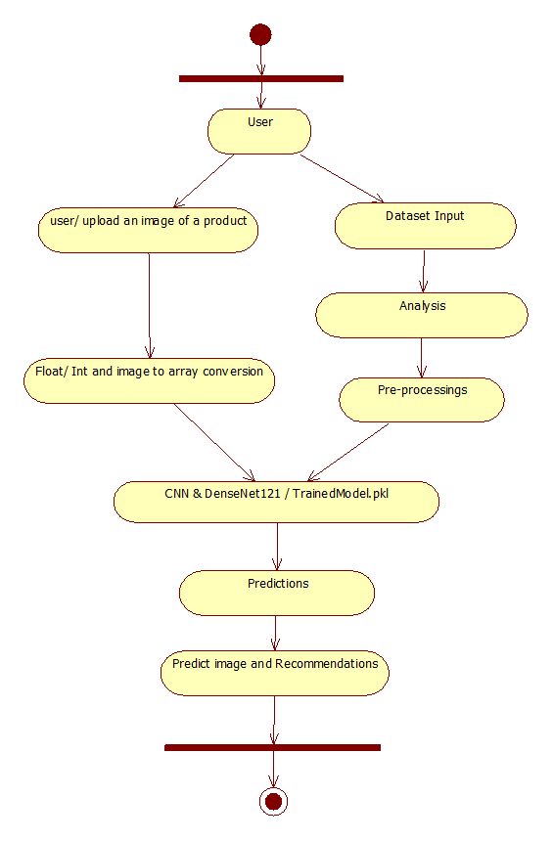
ACTIVITY DIAGRAM
Activity diagrams are graphical representations of workflows of stepwise activities and actions with support for choice, iteration and concurrency. In the Unified Modeling Language, activity diagrams can be used to describe the business and operational step-by-step workflows of components in a system. An activity diagram shows the overall flow of control.

Slide 19
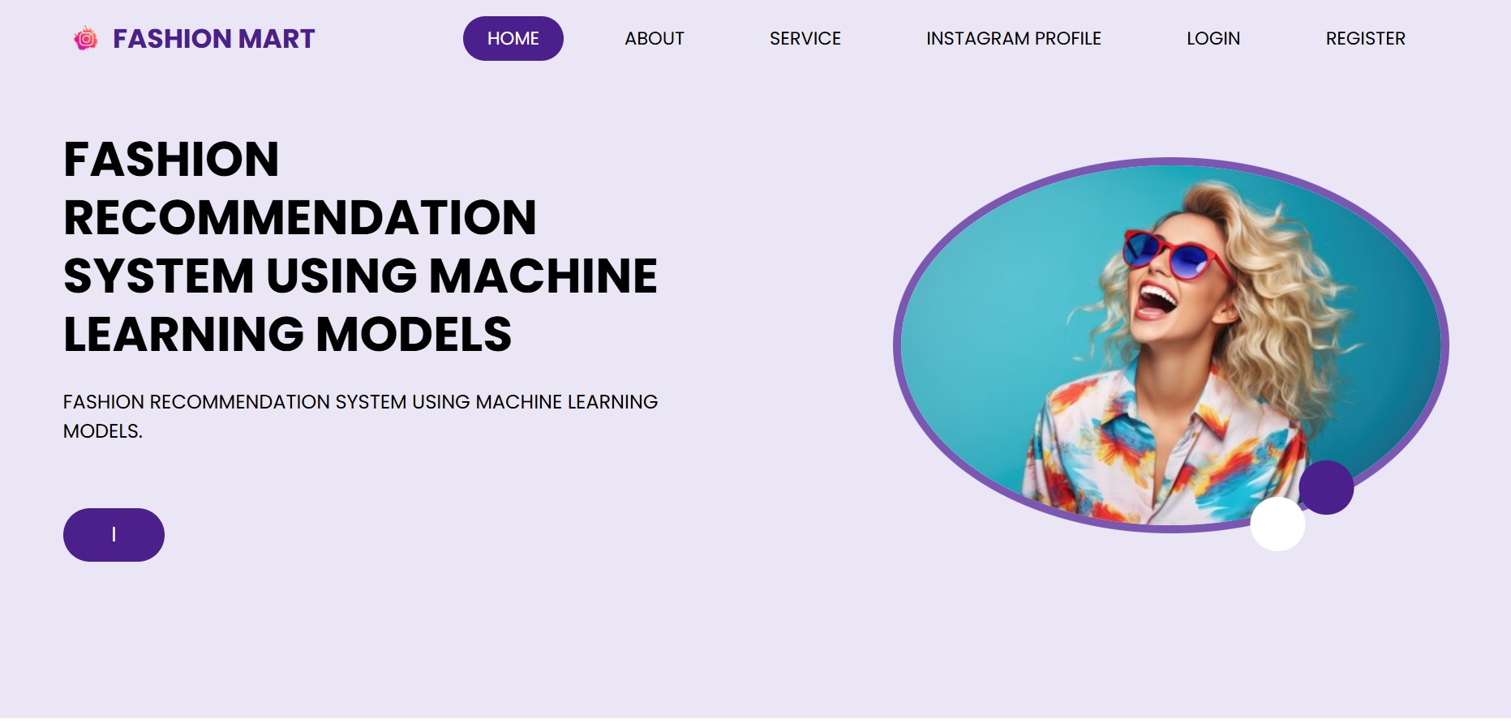
RESULTS
Home page

Slide 20
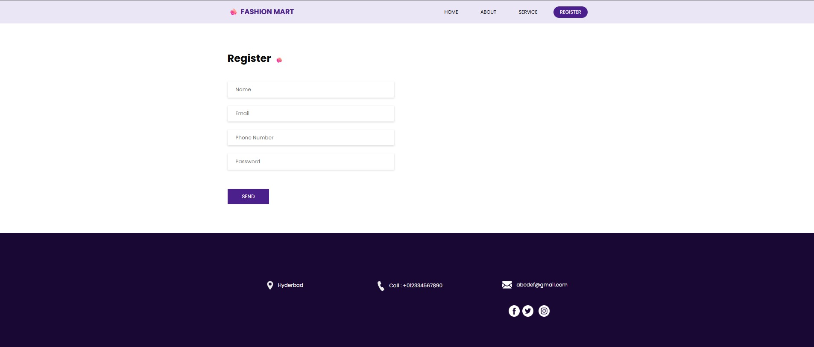
Registration Page

Slide 21
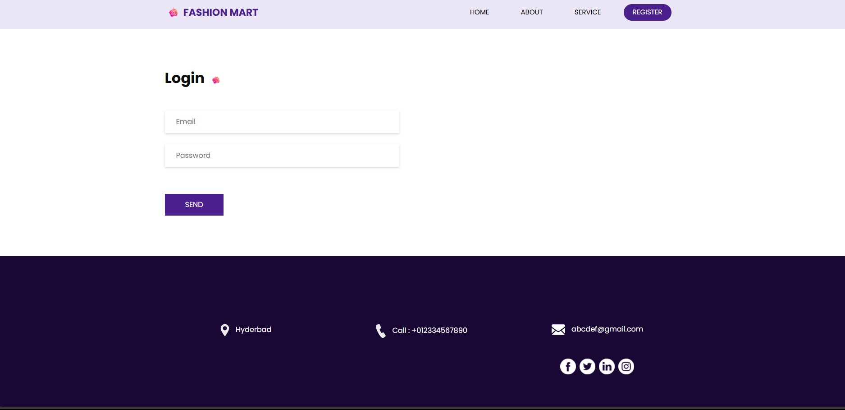
Login Page

Slide 22
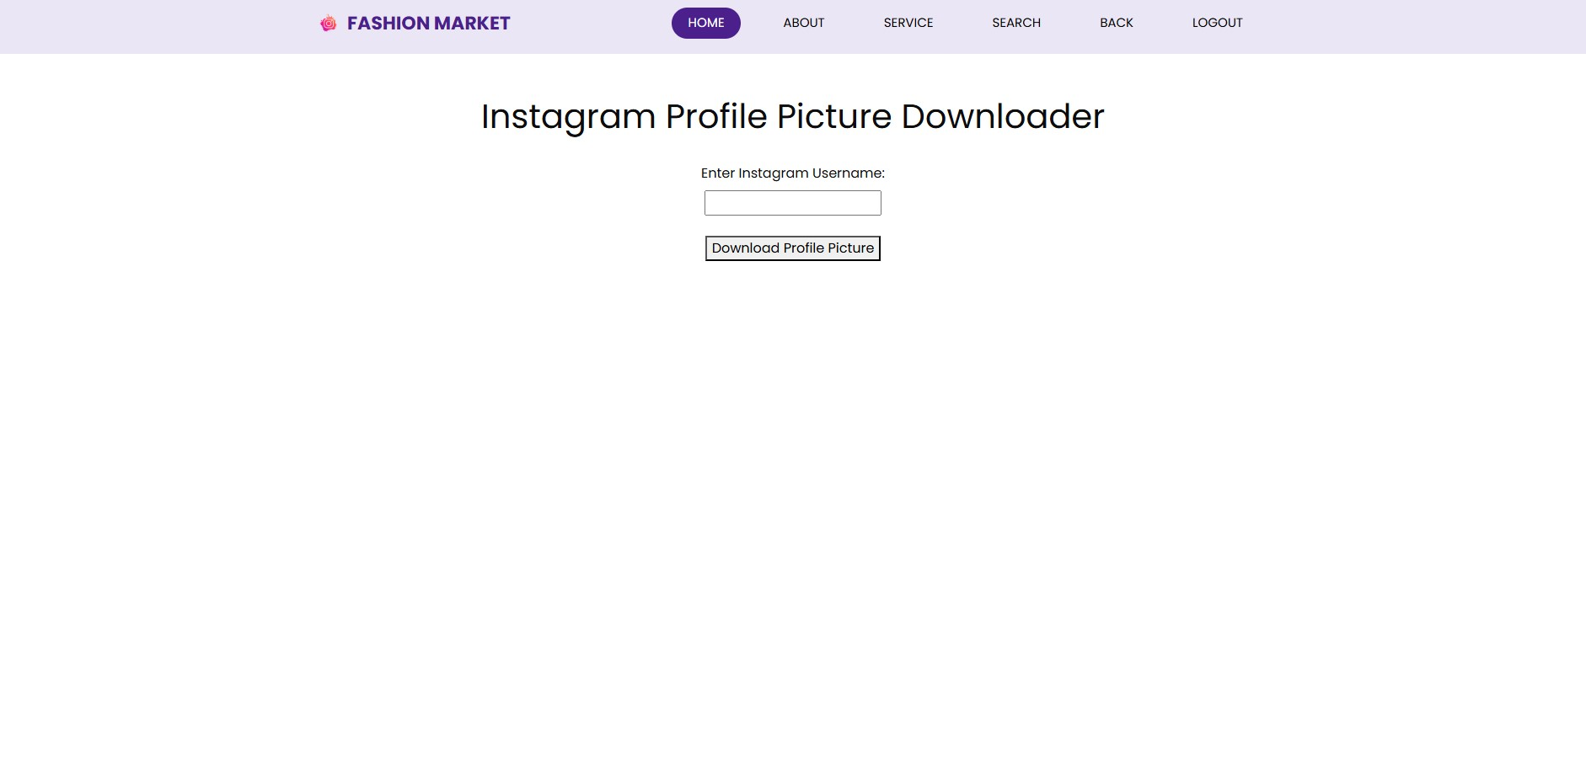
Instagram Input Page

Slide 23
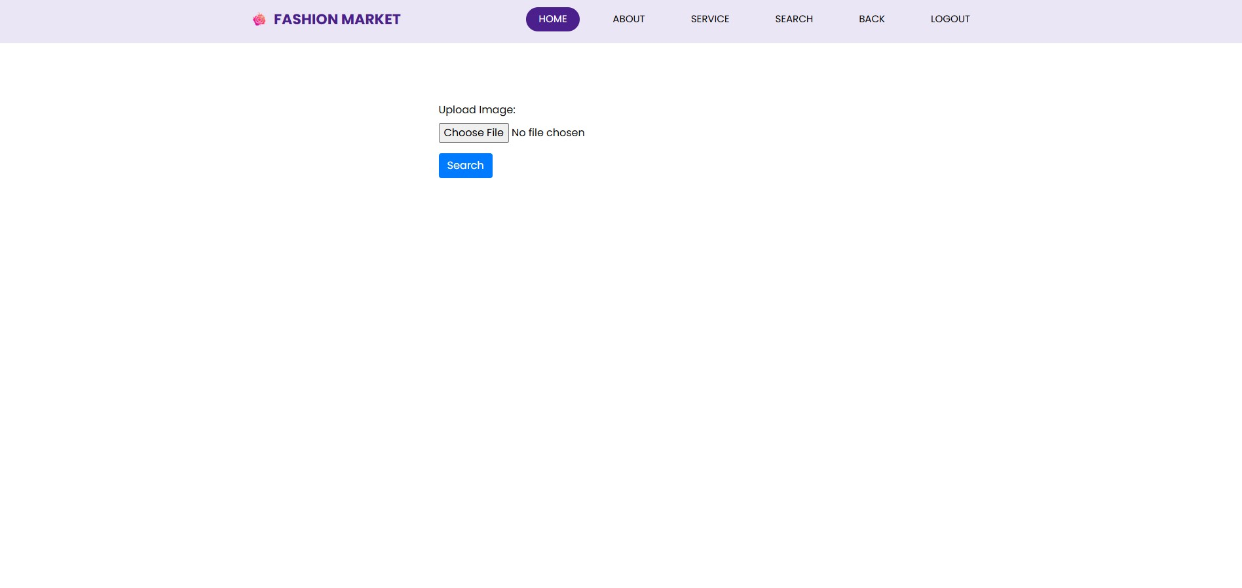
Upload Input page

Slide 24
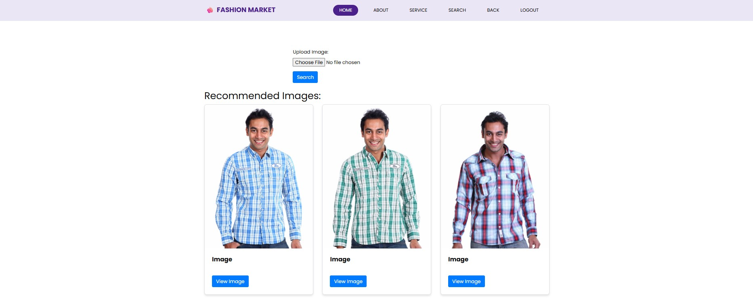
Output Page

Slide 25
SYSTEM REQUIREMENTS
HARDWARE REQUIREMENTS
The hardware requirements may serve as the basis for a contract for the implementation of the system and should therefore be a complete and consistent specification of the whole system. They are used by software engineers as the starting point for the system design. It should what the system do and not how it should be implemented.
· PROCESSOR : DUAL CORE 2 DUOS.
· RAM : 4GB DD RAM
· HARD DISK : 250 GB

Slide 26
SOFTWARE REQUIREMENTS
The software requirements document is the specification of the system. It should include both a definition and a specification of requirements. It is a set of what the system should do rather than how it should do it. The software requirements provide a basis for creating the software requirements specification. It is useful in estimating cost, planning team activities, performing tasks and tracking the teams and tracking the team’s progress throughout the development activity.
Operating System : Windows 7/8/10
Platform : Spyder3
Programming Language : Python
Front End : Spyder3

Slide 27
REFERENCES
A. Adewumi, A. Taiwo, S. Misra, R. Maskeliunas, R. Damasevicius, R. Ahuja, and F. Ayeni, ‘‘A uniﬁed framework for outﬁt design and advice,’’ in Data Management, Analytics and Innovation. Springer, 2020.
T. H. Nobile, A. Noris, N. Kalbaska, and L. Cantoni, ‘‘A review of digital fashion research: Before and beyond communication and marketing,’’ Int. J. Fashion Des., Technol. Educ., pp. 1–9, May 2021.
M. Paolanti and E. Frontoni, ‘‘Multidisciplinary pattern recognition applications: A review,’’ Comput. Sci. Rev., vol. 37, Aug. 2020.
X.Gu, F. Gao, M. Tan, and P. Peng, ‘‘Fashion analysis and understanding with artiﬁcial intelligence,’’ Inf. Process. Manage., vol. 57, no. 5, Sep. 2020.

Slide 28
CONCLUSION
This project successfully developed a fashion recommendation system using social media data. The system leverages user interactions and preferences to provide personalized fashion recommendations. Future work includes exploring advanced machine learning techniques, incorporating user feedback, and expanding the system to incorporate real-time fashion trends.

Slide 29

The image is a project title slide of a document titled "Fashion Recommendation System Using Social Media Website" from the Guru Nanak Institute of Technology. The title is written in red and black text on a white background. Below the title, there is a subtitle that reads "Department of Computer Science and Engineering".
The subtitle reads "Under the guidance of Ms. P.Anusha Assistant professor". Below the subtitle, there are three team members listed - Nikhil Saradhi Kandula , Sravan Rao Kokkirala, and Tejesh Marisetty. The team members are written in black text.
At the bottom of the slide, there has the logo of the institute of technology, which is a red circle with the letters "GNIT" in the center. The logo is a stylized image of a computer monitor with a blue and white color scheme.

